Slide 1
Rates - Review
Miss Lum
Year 11 Essentials

Slide 2
What Can You Remember About rates?
What are some common rates that are used?
Brainstorm ways in which you would need to compare rates and how you would do it?
BE PREPARED TO SHARE

Slide 3
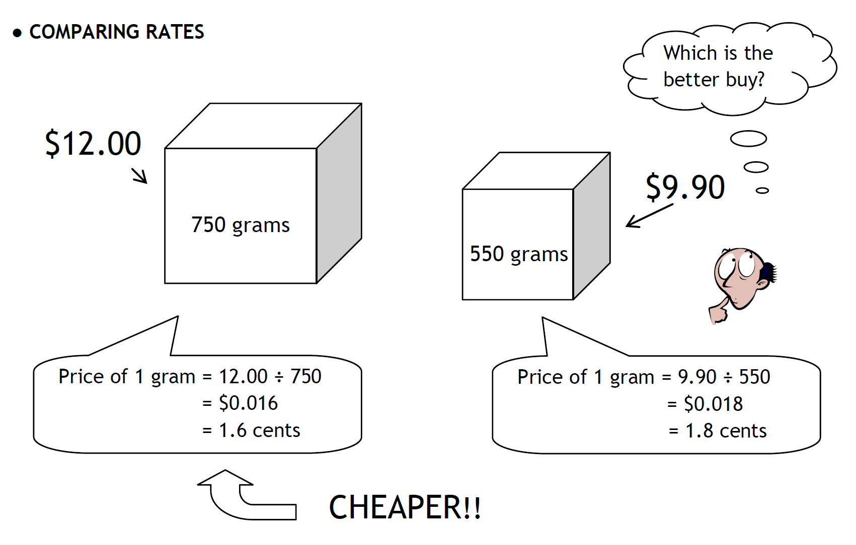
24
7
30
Rates – Unitary Method
Date: 18/09/2018
EQ – How do we use rates?
How do we compare rates to find the best buy?

Slide 4
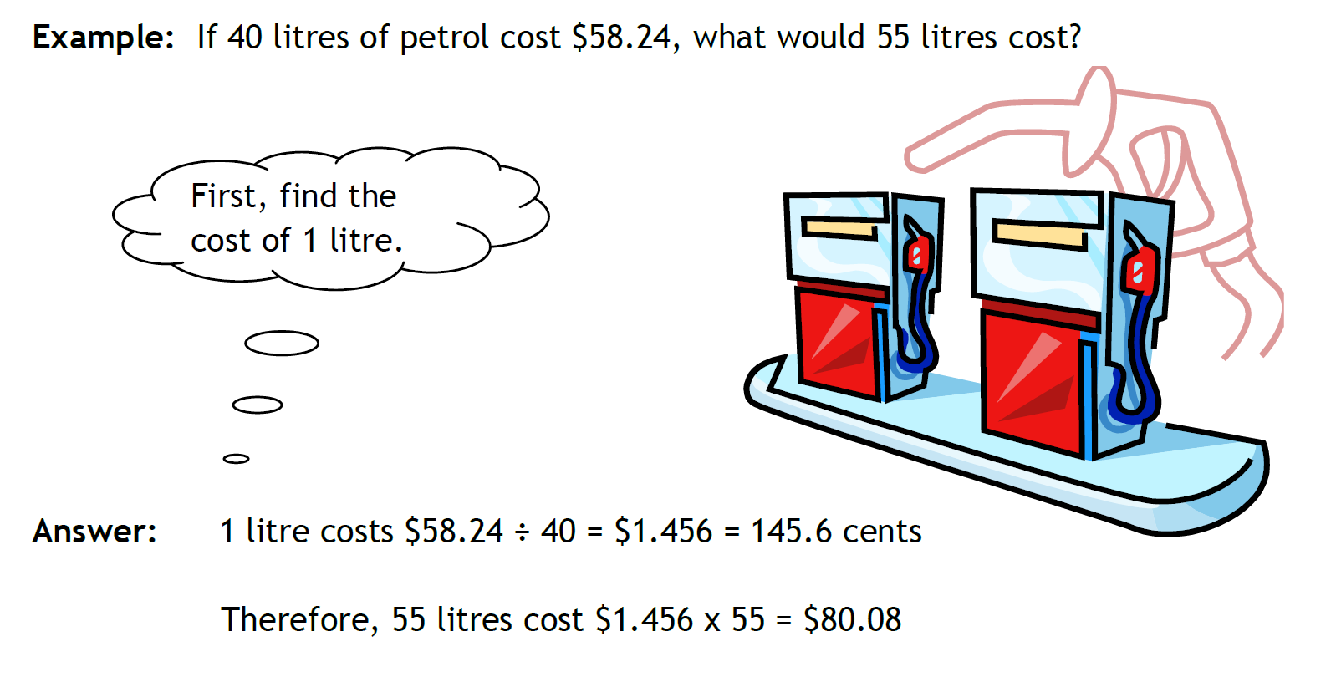
24
7
30
Rates – Review
Date: 18/09/2018
EQ – How do we use rates?
How do we use rates to calculate costs of items of different amounts?

Slide 5
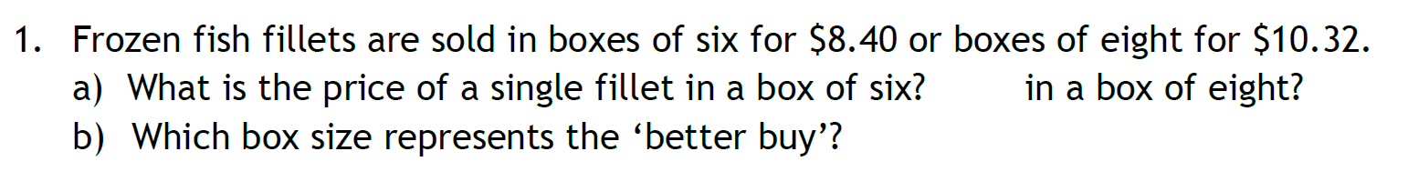
TASK

Slide 6
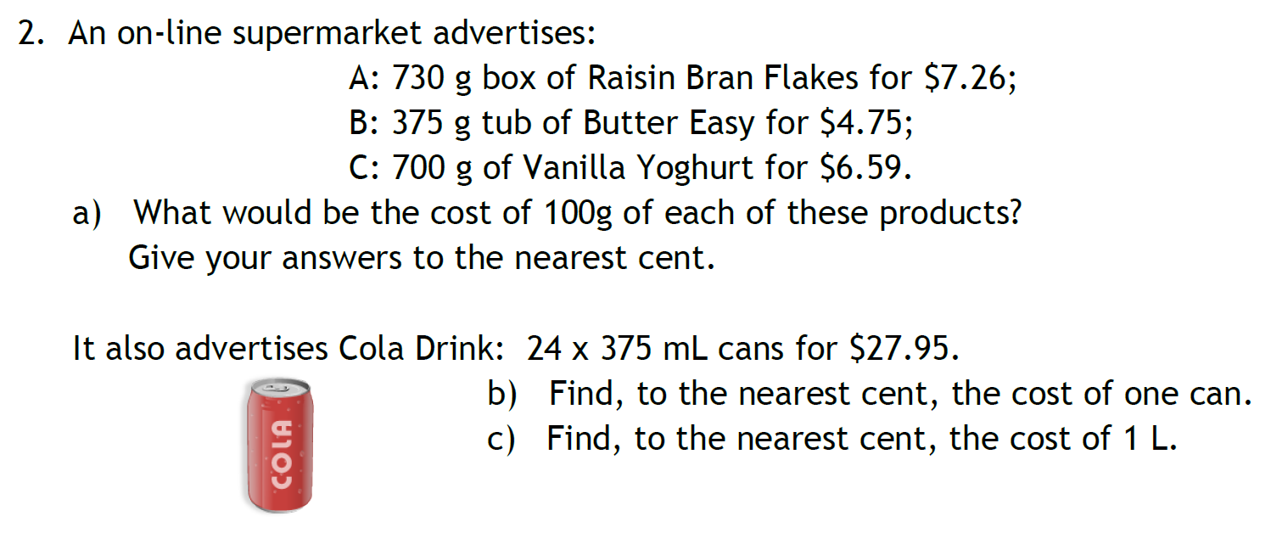
TASK

Slide 7
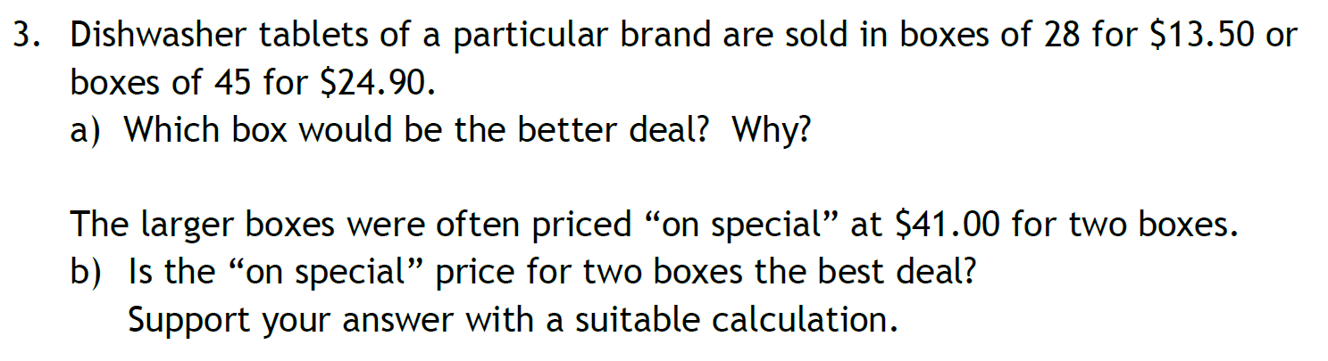
TASK

Slide 8
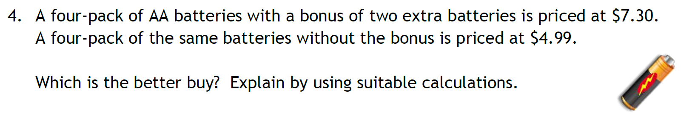
TASK

Slide 9
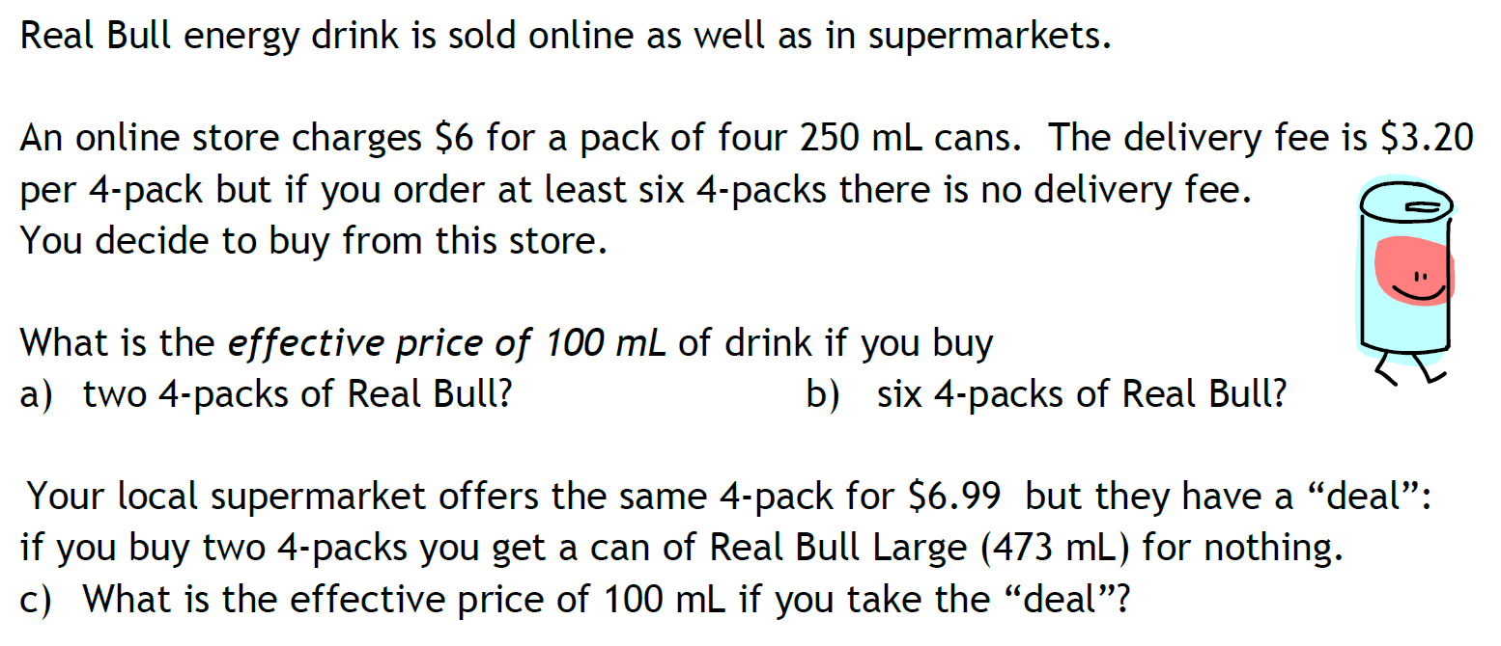
TASK

